Slide 1
Curriculum Changes
and
Other Academic Proposals:
The Review Process
Kyle Smith
kylesmith@triton.uog.edu
Senate Parliamentarian
and
Chair, Standing Committee on Institutional Excellence

Slide 2
Why learn this now?

Slide 3
Why learn this now?

Slide 4
Why learn this now?
New courses?
New online sections?
Strengthening your major?
New degree program?

Slide 5
The Academic Proposal Review Process
Program faculty
Division or Administrative Chair
College AAC or Curriculum Comm.
Dean
Senate and its committees (online courses need TADEO review also)
Senior Administration

Slide 6
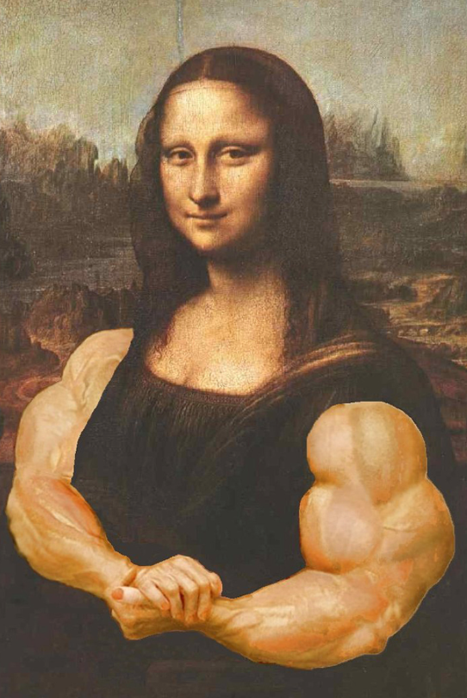
Strengthening your proposal

Slide 7
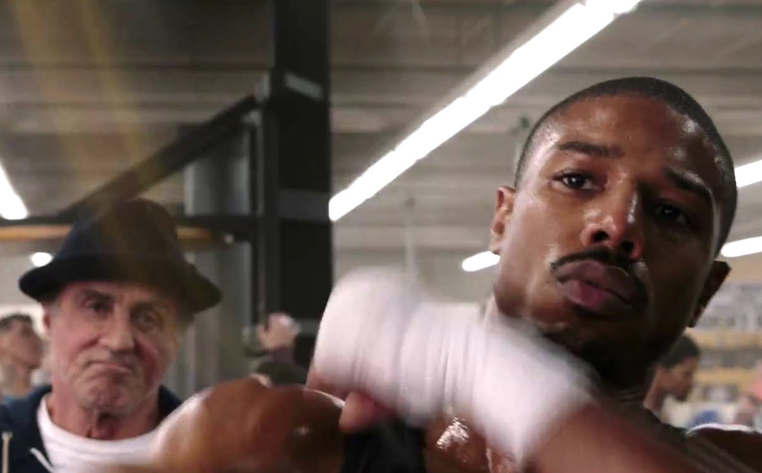
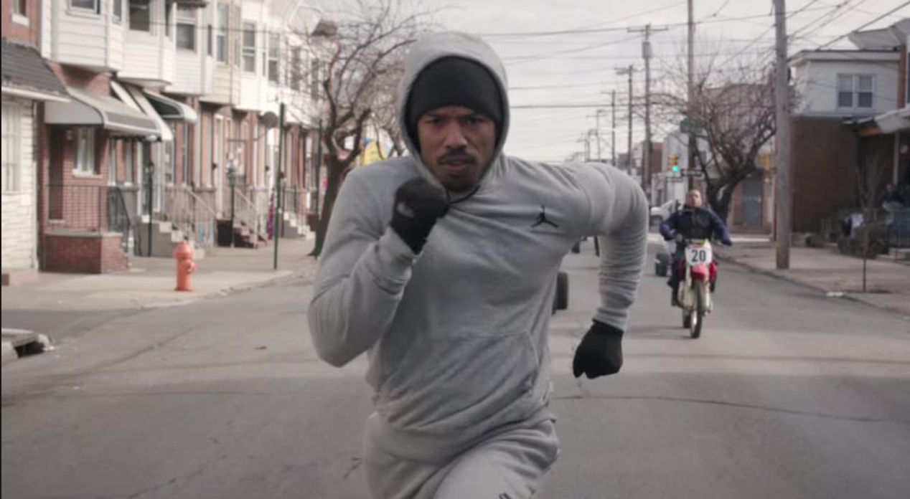
Preparing for Senate Meetings

Slide 8
Criteria for Senate Endorsement:
Is the proposal…
…well-researched and critically examined?
…complete and of high quality?
…compatible with the broad inter-collegiate interests of the University, as seen by the faculty?
…prepared according to the University’s rules and procedures?
Did the faculty have an appropriate role in the proposal’s development?

Slide 9
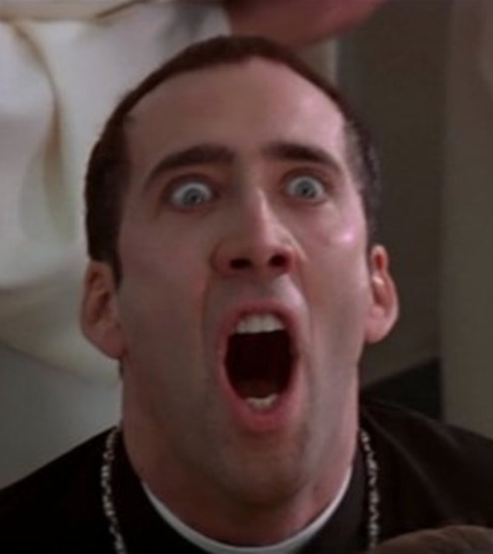
What if the Senate votes not to endorse my proposal?

Slide 10
What if the Senate votes not to endorse my proposal?
You have the option to revise, or continue.
The Senior Administration will have the final say.

Slide 11
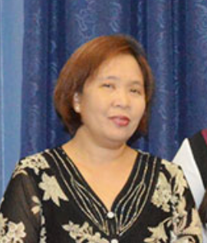
Helpful Contacts
Dr. Suzanne Bells-McManus, Chair
Undergraduate
Curricula Review Committee
suzannebm@triton.uog.edu
Dr. Leila Kabigting, Chair
Graduate
Curricula Review Committee
kabigtingl@triton.uog.edu
Manuel (Manny) Hechanova,
Associate Director
TADEO
mannyh@triton.uog.edu

